Slide 1
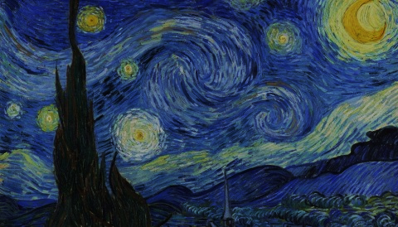
Overview
November 20th
Gravitational Waves
Introduction to Dark Matter (history, evidences)
December 4th
Dark Matter “Theory”
Cosmology, History of the Universe, ΛCDM Cosmological Model
Dark Matter in Cosmology
Nucleosynthesis
December 11th
Dark Matter “Experiments”
Phenomenology of Dark Matter
Experimental Searches
Notes:
<number>
<number>

Slide 2
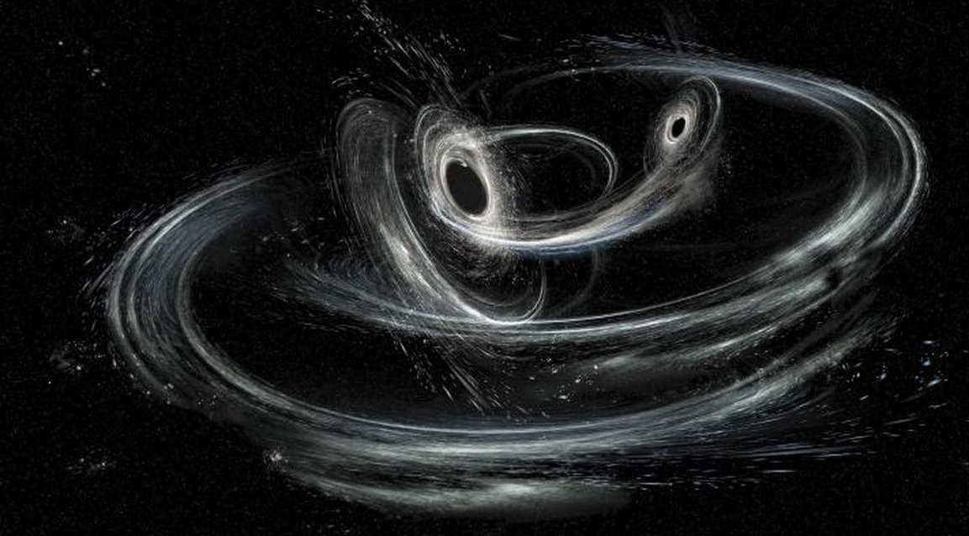
Gravitational
Waves
Astroparticle Physics
Part 4 – WS 2019
Federico Ambrogi
<number>
Notes:
<number>
<number>
<number>

Slide 3
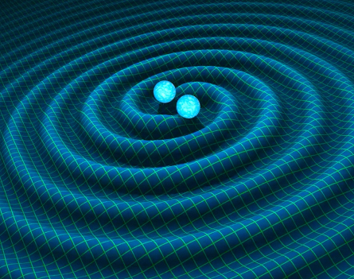
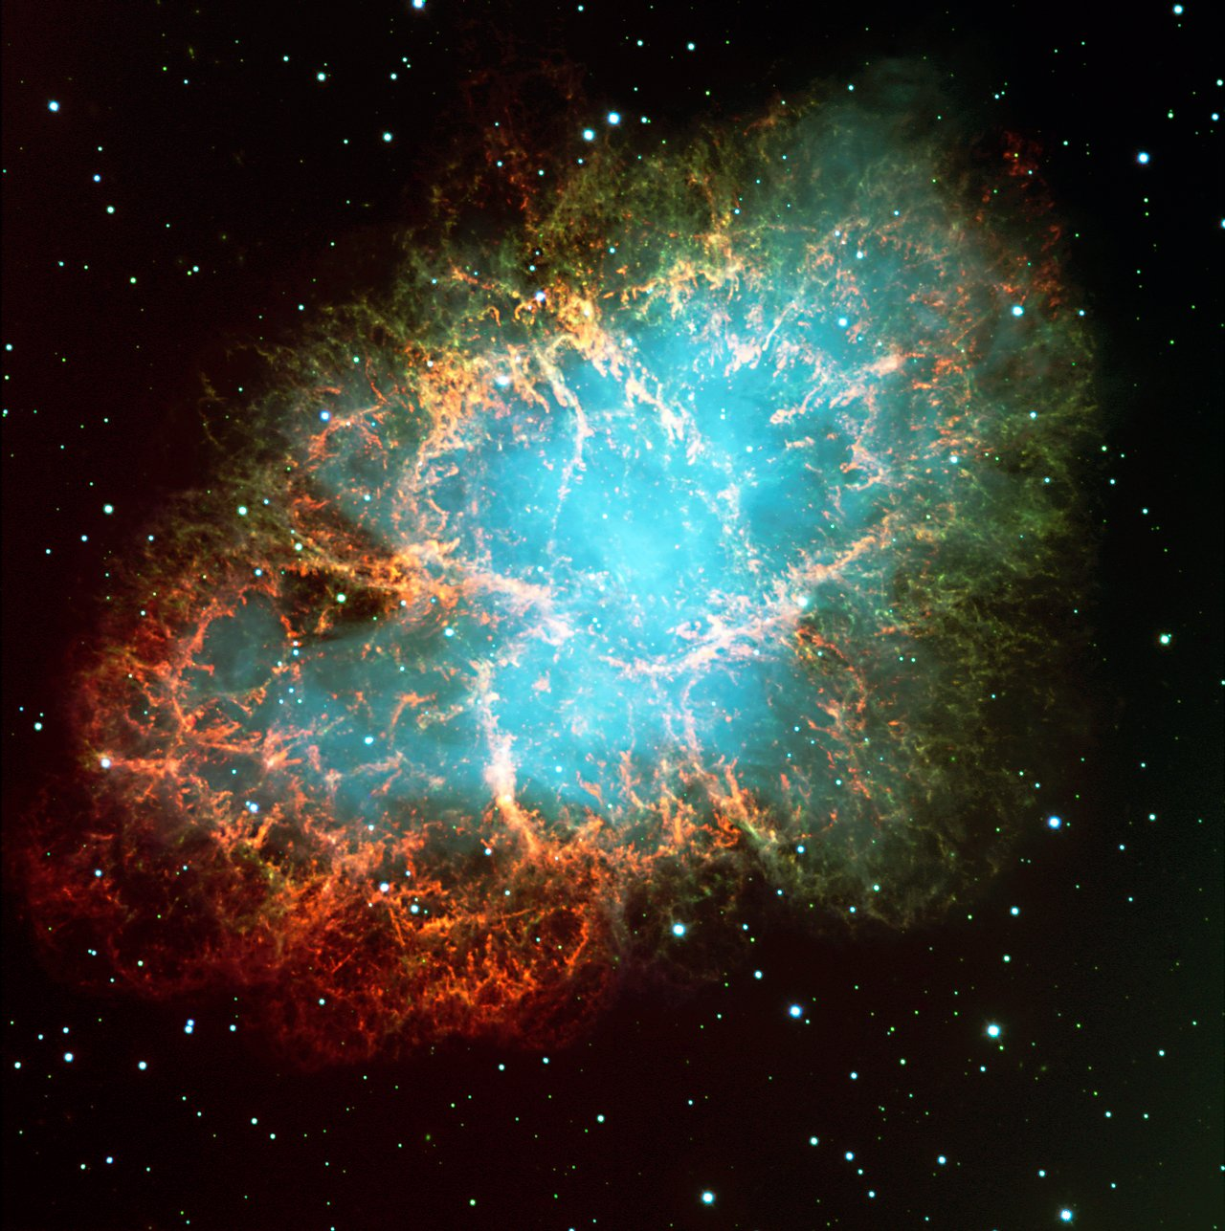
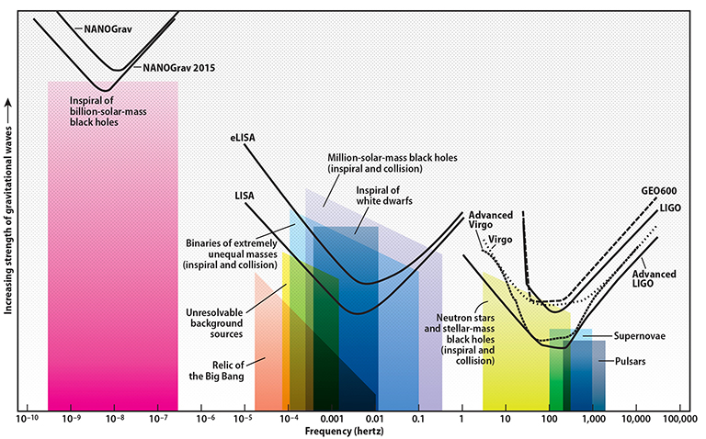
Overview
Gravitational Waves (GWs) represent one of the hot topic in current Astrophysics
Another fundamental proof that Einstein‘s general relativity is correct
Give complementary and independent measurements of astrophysical/cosmological parameters
Allow to observe atrophysical objects/events that cannot be seen with electromagnetic waves or cosmic rays
Allow to test the ΛCDM Cosmological Model and the evolution of the universe
(...)
In this lecture:
Introduction to GWs
Sources: Black Holes, Neutron Stars
Interferometry: LIGO, VIRGO, LISA
Characterization of GW events
Multimessenger astronomy
Astroparticle Physics - Part 3 Gravitational Waves
<number>
Notes:
<number>
<number>

Slide 4
Introduction
Gws: “ripples” or distortion in the space-time fabric travelling at the speed of light (c) .
Through their propagation, they distort the space and time around massive bodies or massless particles
In particular, GW change the distance between two fixed points
The amplitudes and the frequencies of the waves depend on the sources
How do we detect Gws?
What produces Gws?
Supermassive black holes,
formation of black holes,
binary systems,
early universe dynamics etc.
https://arxiv.org/abs/1703.00187
https://www.tat.physik.uni-tuebingen.de/~kokkotas/Teaching/NS.BH.GW_files/GW_Physics.pdf
Astroparticle Physics - Part 3 Gravitational Waves
<number>
Notes:
<number>
<number>

Slide 5
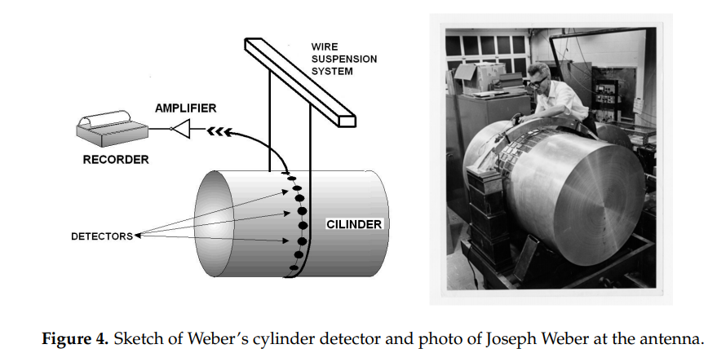
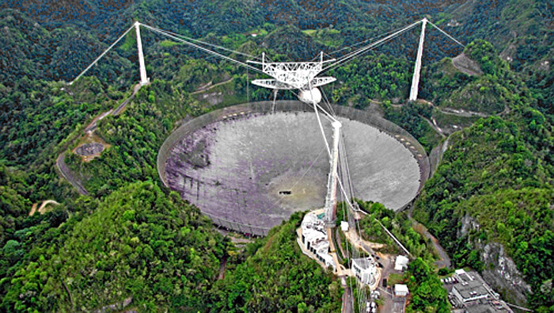
What are these Gravitational Waves ???
https://www.mdpi.com/2218-1997/2/3/22/pdf
“One of the first predictions of General Relativity (GR, 1916)”
Einstein immediately started working on the solution of his field equation in the form of waves
It took > 50 years to derive generally accepted solutions & the proper equations for the wave forms
~1970s: claim by Weber of the observation of GWs (not confirmed by other similar experiments)
1974: discovery of the binary system SR B1913+16 (and the Hulse–Taylor binary) → first indirect test of Gws emission
Arecibo (Puerto Rico) telescope: 305-meter radio telescope, world's largest single-aperture telescope (until 2016, with the Chinese FAST telescope)
Astroparticle Physics - Part 3 Gravitational Waves
<number>
Notes:
<number>
<number>

Slide 6
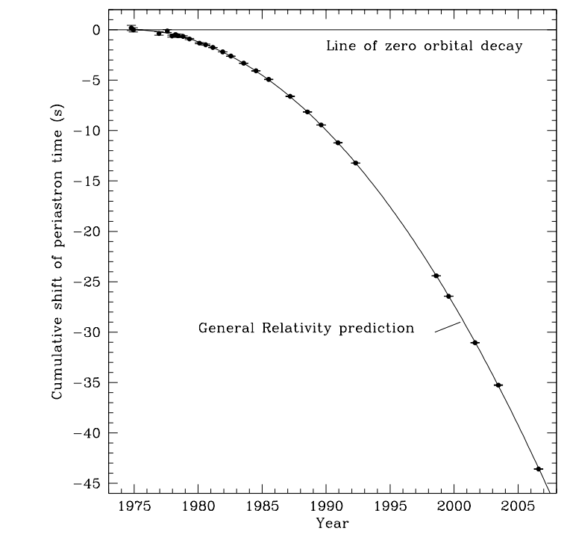
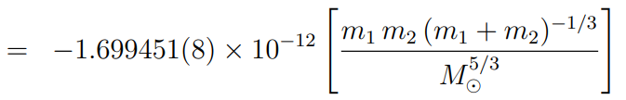
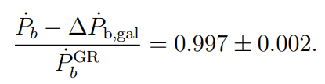
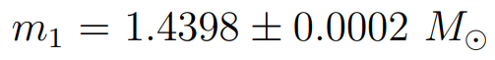
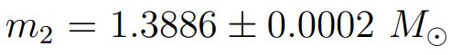
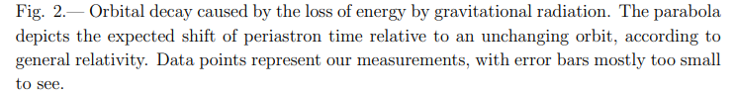
The Hulse-Taylor Binary Pulsar PSR B1913+16
Double neutron stars binary system first observed in 1974
According to general relativity a binary star system should radiate energy in the form of gravitational waves
Rate of change in orbital period (Peters and Matthews,1963):
https://arxiv.org/pdf/1011.0718.pdf
Ratio observation vs prediction accounting for galactic corrections
~30 years of observation
“As we have shown before, this result provides conclusive evidence for the existence of gravitational radiation as predicted by Einstein’s theory.”
Astroparticle Physics - Part 3 Gravitational Waves
<number>
Notes:
<number>
<number>

Slide 7

What are these Gravitational Waves ???
“One of the first predictions of General Relativity (GR, 1916)”
Einstein immediately started working on the solution of his field equation in the form of waves
It took > 50 years to derive generally accepted solutions & the proper equations for the wave forms
1974: discovery of the binary system SR B1913+16 (and the Hulse–Taylor binary) → first indirect test of Gws emission
[1993 Nobel prize to Hulse and Taylor]
14th September 2016 at 09:50:45 UTC: First observation of GW150914 (event of two black holes merger)
11th February 2016: announcement of the first neutron stars (NS) mergers by the Gravitational-Wave Observatory LIGO (LIGO + VIRGO)
1st December 2018: catalog of 11 GW events (10 BH , 1 NS) from the first two observation Runs
Now: O3, Run 3 of observation (LIGO+VIRGO+KAGRA in December 2019)
Astroparticle Physics - Part 3 Gravitational Waves
<number>
Notes:
<number>
<number>

Slide 8
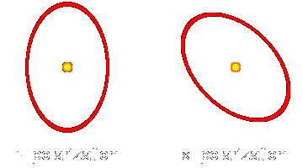
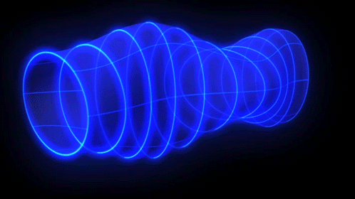
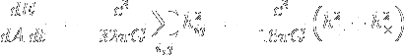
Basic Properties
After production, GW propagate basically unaltered (no interaction with the intergalactic medium)
Wave amplitude decrease with propagation
Can be redshifted (cosmological, gravitation and Doppler redshift)
Their wave form (amplitude, frequency) carries the information of their source
More exotic effects (hard to calculate analytically, dropping linearized theory) might distort the wave from
Produced by time variations of the mass quadrupole moment of the source
Two polarization states
Carry energy
While you can have emission of EM waves from time derivative of a dipole, the derivative of a dipole of an isolated mass is zero since it equals to momentum conservation
http://www.tapir.caltech.edu/~teviet/Waves/gwave_details.html
The energy flux (i.e. the energy dE crossing an area dA orthogonal to the direction of the wave in a time dt) is given by
Astroparticle Physics - Part 3 Gravitational Waves
<number>
Notes:
<number>
<number>

Slide 9
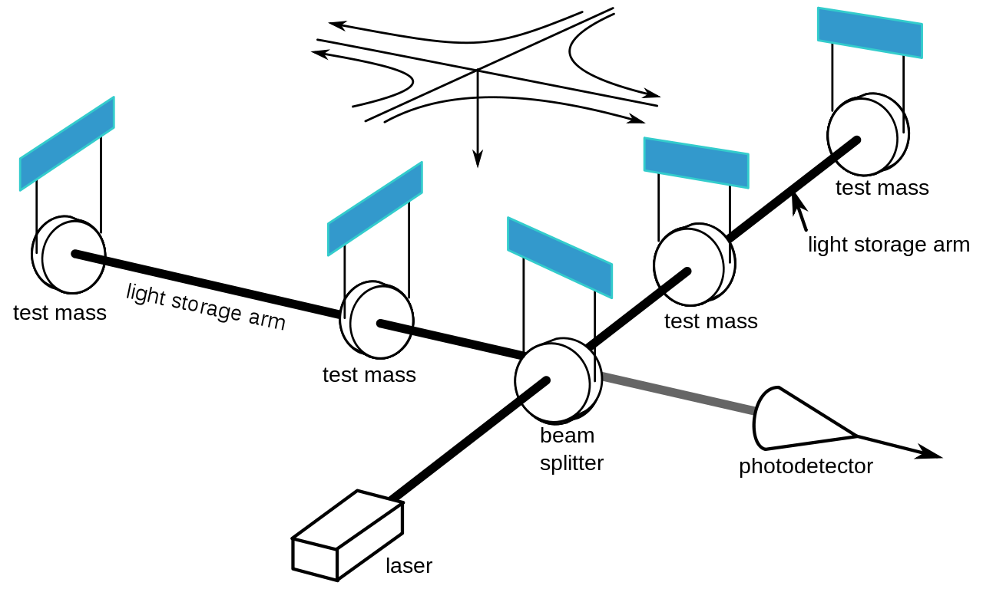



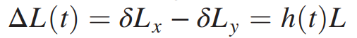
The Interferometers
LIGO: the Laser Interferometer Gravitational-Wave Observatory (LIGO)
VIRGO: Pisa (Italy)
Handford (Washington) and Livingstone (Louisiana)
https://www.ligo.caltech.edu/page/what-is-interferometer
Principles of Michelson’s Interferometers
The passage of gravitational waves, with strain amplitude h (related to the actual amplitude of the GW) causes the modification of the length of the orthogonal arms Lx and Ly (=4 Km) of the interferometer:
An interference pattern will then appear in the photodetector
The optical signal is proportional to the GW strain
Nd:YAH laser, 1064 nm; 20kW at source, amplified to 100kW circulating in the arms
2nd best vacuum created on Earth (1st: LHC), Pressure < 1 micro Pascal
Test masses = mirrors
Their relative position is affected by the passage of the GW
Astroparticle Physics - Part 3 Gravitational Waves
<number>
Notes:
<number>
<number>

Slide 10
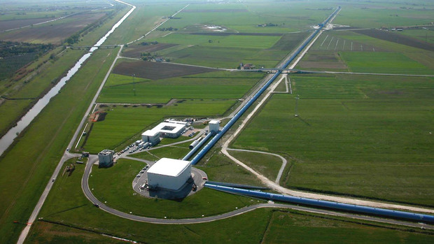
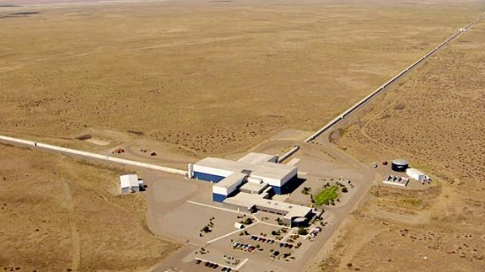
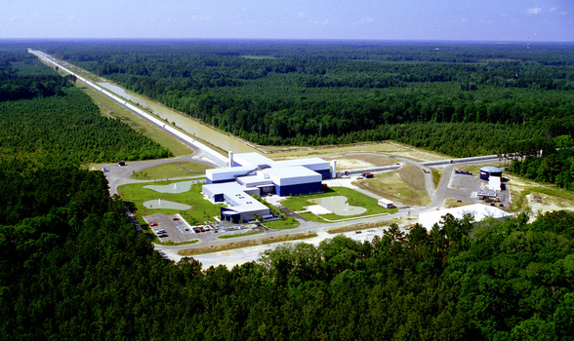
The Interferometers
Virgo (Pisa,Italy)
LIGO (Handford, USA)
+ KAGRA (Japan): “KAGRA to Join LIGO and Virgo in Hunt for Gravitational Waves news from 4th October 2019 ” , observation run from Dec. 2019
+ LIGO India (~2025)
LIGO (Livingstone, USA)
Astroparticle Physics - Part 3 Gravitational Waves
<number>
Notes:
<number>
<number>

Slide 11
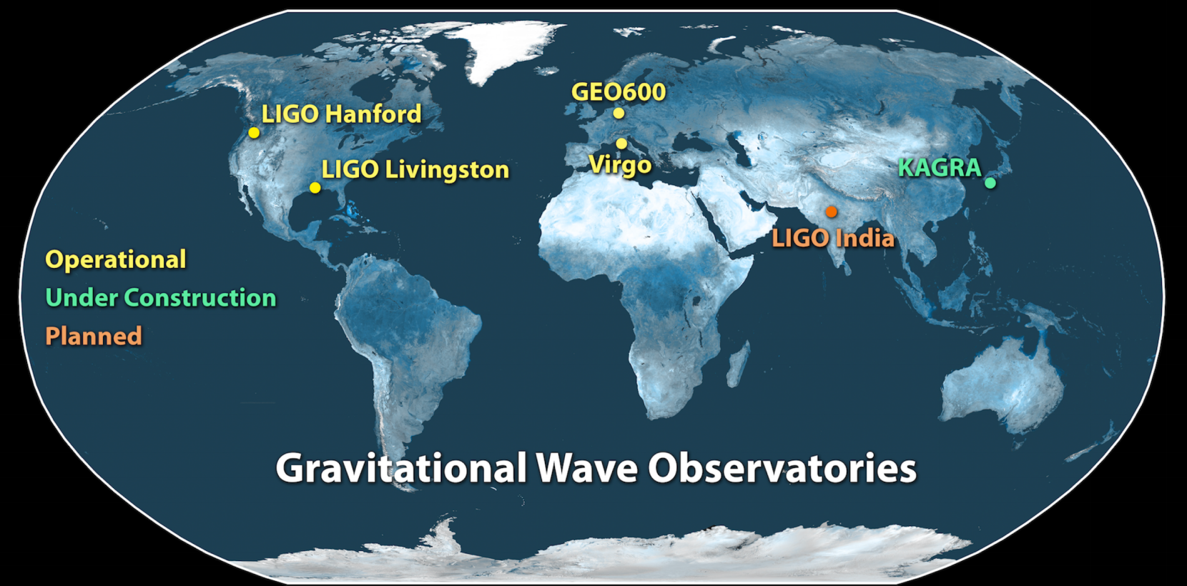
The Interferometers
Astroparticle Physics - Part 3 Gravitational Waves
<number>
Notes:
<number>
<number>

Slide 12
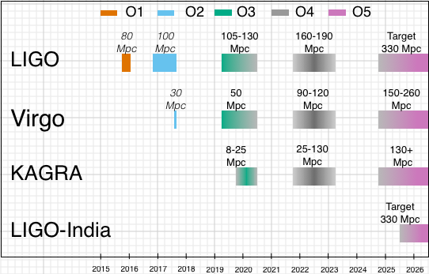
The Interferometers
https://www.gw-openscience.org/alerts/
From GCN Circular 24045:
Our third observing run ("O3") began as scheduled on 2019 April 1 at 15:00 UTC.
[…]
As of April 2 20:00 UTC, we have configured our low-latency analysis pipeline to send public alerts for significant gravitational-wave transient candidates that are detected in coincidence across two or more gravitational-wave detectors.
Automated Preliminary GCN Notices will be sent immediately without any human intervention. Shortly afterward, they will be vetted by an LSC/Virgo rapid response team and either confirmed with an Initial GCN Notice and Circular, or withdrawn with a Retraction.
Retraction notices may be issued more frequently over the next few weeks as our understanding of the instrumental background improves.
[…]
This marks the beginning of the era of public alerts for the field of gravitational-wave astronomy.
LIGO Run O3 just restarted after ~1 month break
KAGRA should be online by December 2019
+ Multimessenger Astronomy
Astroparticle Physics - Part 3 Gravitational Waves
<number>
Notes:
<number>
<number>

Slide 13
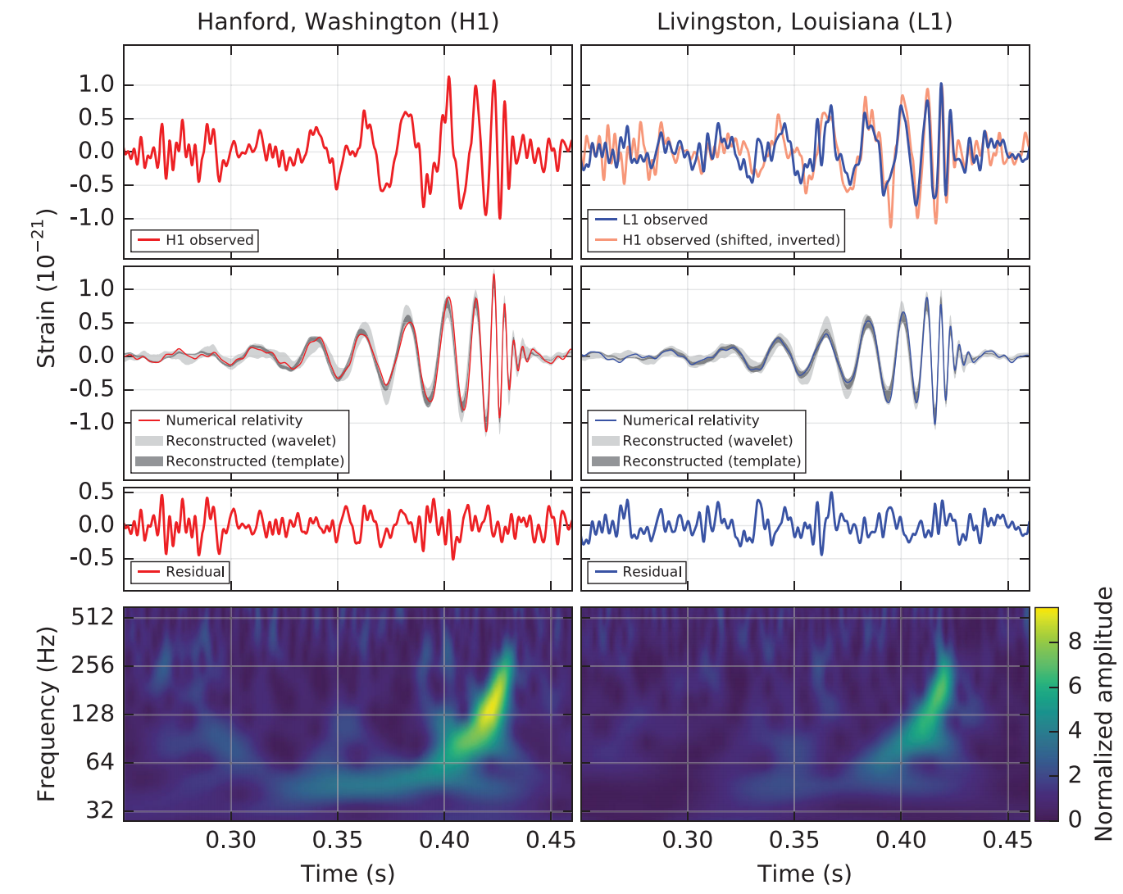
The first event: GW150914 (BBH, Binary Black Holes)
Simultaneous observation of a transient gravitation wave signal by the two LIGO observatories on September 14, 2015
First direct detection of gravitational waves
First observation of a binary black hole merger
Probability of fake signal: 1/203.000 years
Over 0.2 s, the frequency increases from 35->150 Hz and the amplitude reaches a peak
Time (s) from 09:50:45 UTC
Astroparticle Physics - Part 3 Gravitational Waves
<number>
Notes:
<number>

Slide 14
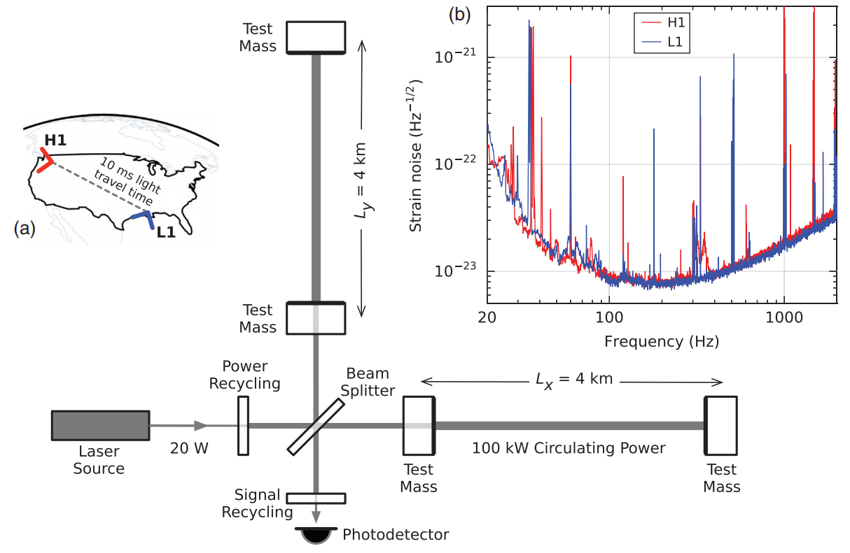
The first event: GW150914 (BBH, Binary Black Holes)
Instrumental noise converted to strain amplitude of the instrument close to the time of detection
Peaks correspond to calibration lines, vibration modes of suspension fibers, power grid harmonics
No environmental disturbances measured by surrounding instruments (seismometers, accelerometers, microphones, magnetometers, radio receivers, weather sensors, ac-power lines monitors, cosmic-rays detectors), fluctuations estimated below 6% of total GW strain
GWs are searched in the data of the two detectors were the events are compatible with the GW propagation time H1<->L1
( Note that GW themselves constitute a background for the measurements)
Astroparticle Physics - Part 3 Gravitational Waves
<number>
Notes:
<number>

Slide 15
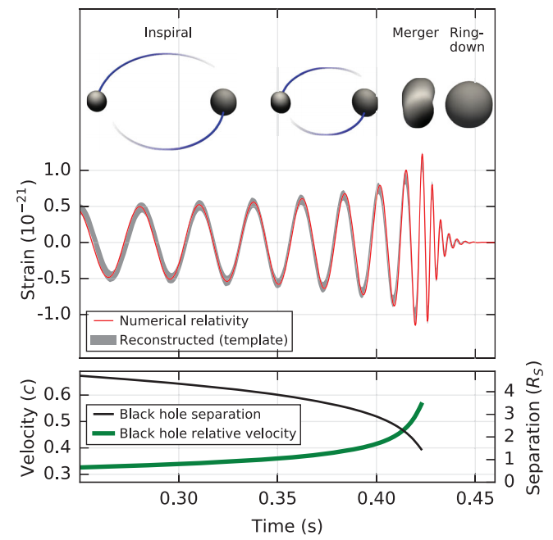
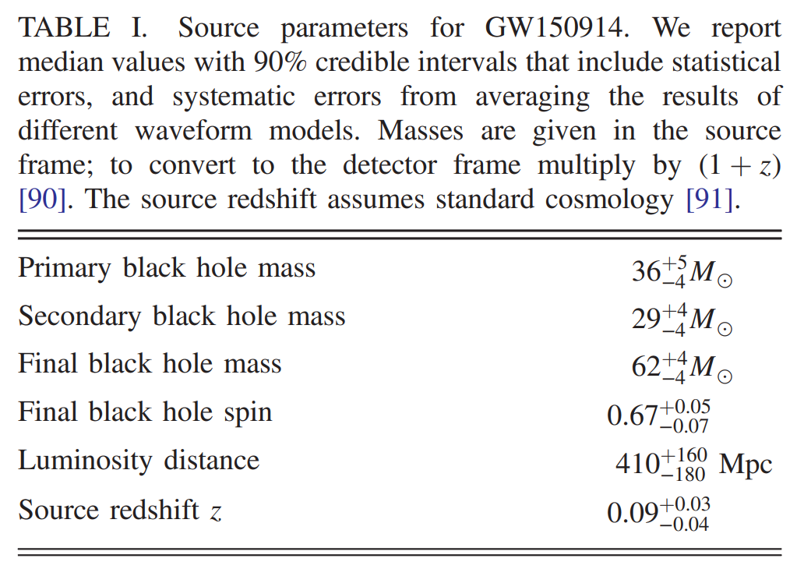
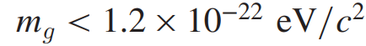
The first event: GW150914 (BBH, Binary Black Holes)
Possible explanation: coalescence of black holes, i.e. their orbital inspiral and merger and final BH ringdown
Source distance: 410+160 −180 Mpc (redshift z =0.09^{+0.03} _{−0.04}).
Initial black hole masses 36⁺⁵ ₋₄ M ⊙ and 29⁺⁴ ₋₄M⊙, and the
Final BH mass is 62⁺⁴ ₋₄ M ⊙
Energy of 3.0^{+0.5}_{−0.5}M⊙c² radiated in gravitational waves
Also possible to estimate the mass (upper limit) of the associated graviton:
Rs = Schwarzschild radius
Note: extensive searches for EM follow up of the GW events were performed
EM emission is expected when neutron stars are involved in the merging
See e.g.
http://www.esa.int/Science_Exploration/Space_Science/Integral_sets_limits_on_gamma_rays_from_merging_black_holes
→ 2018 Catalog: 10 GWs events from BBHs
Astroparticle Physics - Part 3 Gravitational Waves
<number>
Notes:
<number>
Masses of the black holes are plausible???

Slide 16
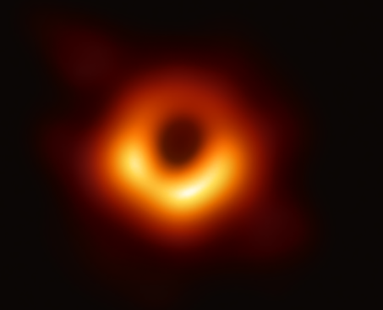
Black Holes
Since April 10th 2019 : we „see“ them! Event Horizon Telescope Collaboration
https://eventhorizontelescope.org/blog/first-ever-image-black-hole-published-event-horizon-telescope-collaboration
https://eventhorizontelescope.org/press-release-april-10-2019-astronomers-capture-first-image-black-hole
Scientists have obtained the first image of a black hole, using Event Horizon Telescope observations of the center of the galaxy M87. The image shows a bright ring formed as light bends in the intense gravity around a black hole that is 6.5 billion times more massive than the Sun. This long-sought image provides the strongest evidence to date for the existence of supermassive black holes and opens a new window onto the study of black holes, their event horizons, and gravity.
Note: 6.5x10⁹ M○ >> than the typical mass of BH detected by gravitational waves M_{BH,gw} ≈ 40 M○
i.e. two different types of BHs
Astroparticle Physics - Part 3 Gravitational Waves
<number>
Notes:
<number>
<number>
<number>

Slide 17
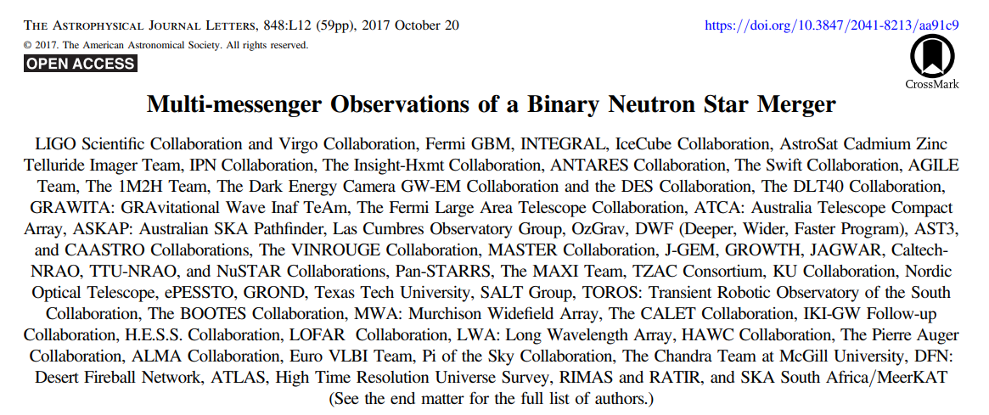
GW170817 Binary Neutron Stars Merger and Multi-Messenger Astronomy with GWs
Astroparticle Physics - Part 3 Gravitational Waves
<number>
Notes:
<number>
<number>

Slide 18
GW170817 Binary Neutron Stars Merger and Multi-Messenger Astronomy with GWs
(953 authors)
[ Higss boson discovery paper,
ATLAS+CMS Collaborations: 5,154 Authors ]
Astroparticle Physics - Part 3 Gravitational Waves
<number>
Notes:
<number>
<number>

Slide 19
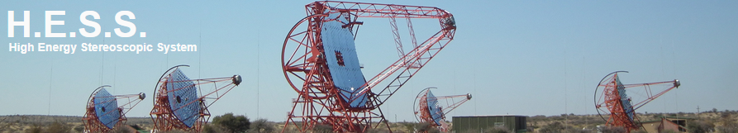
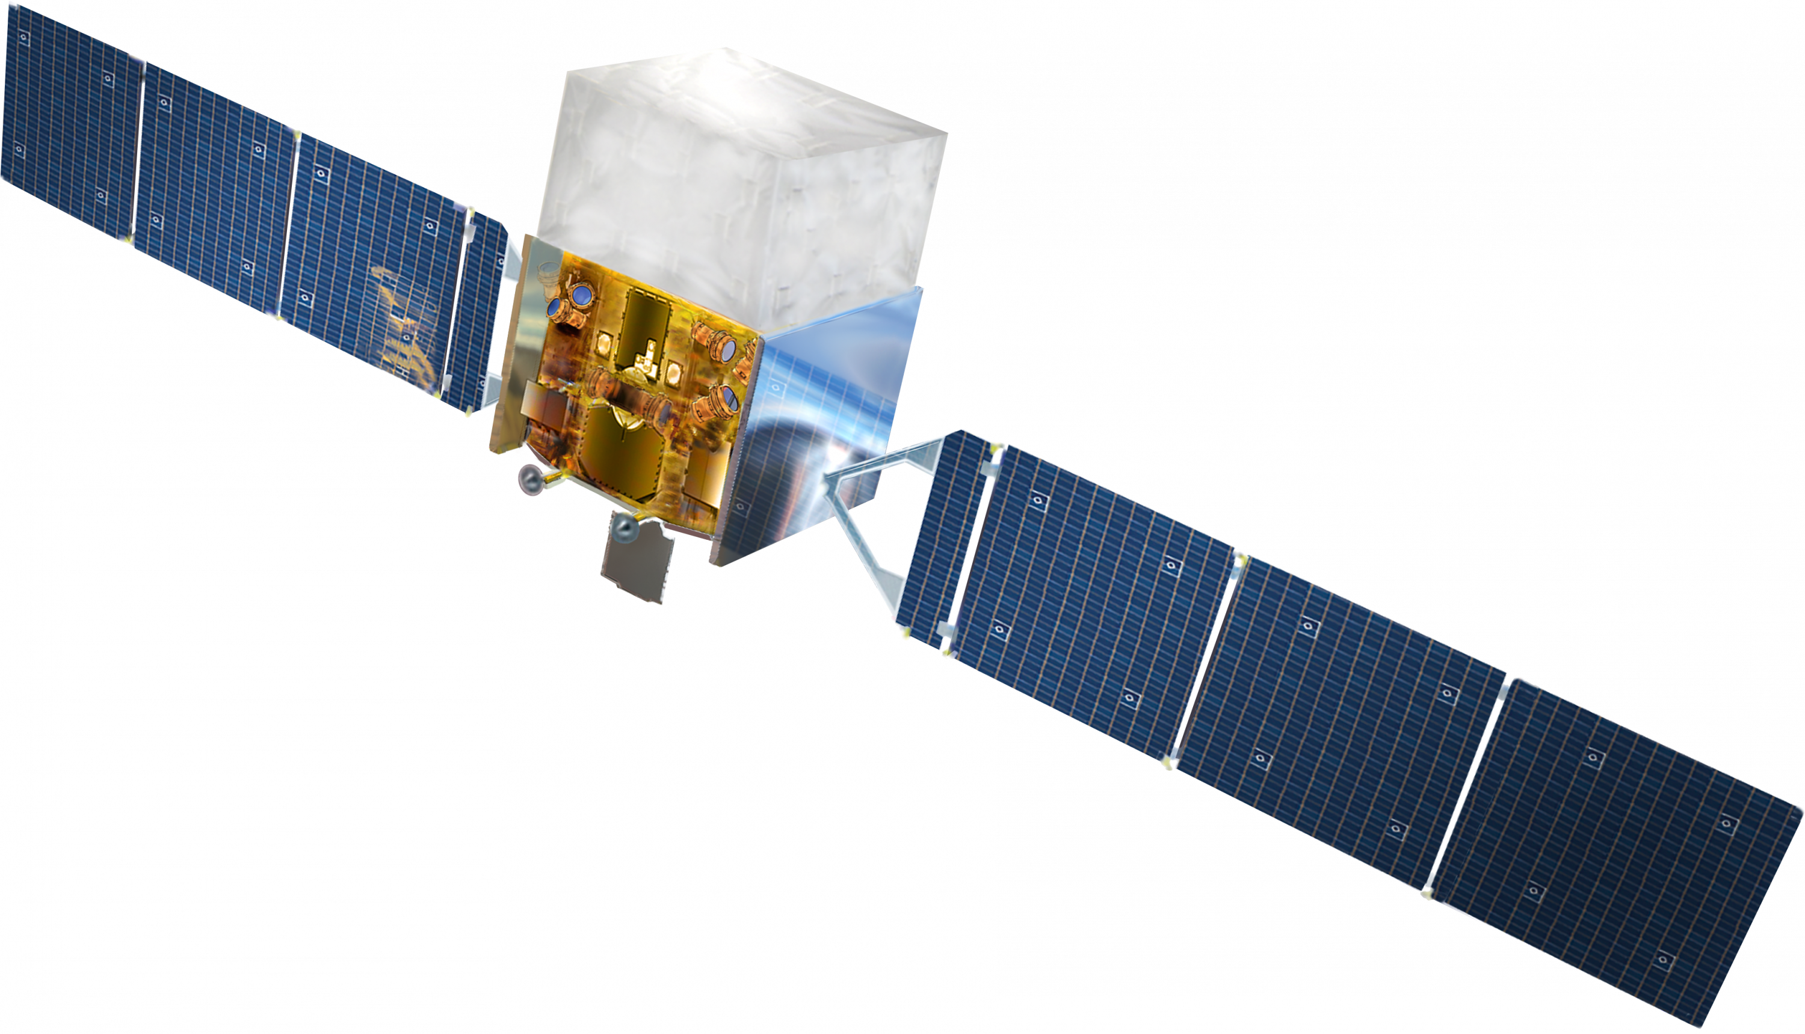
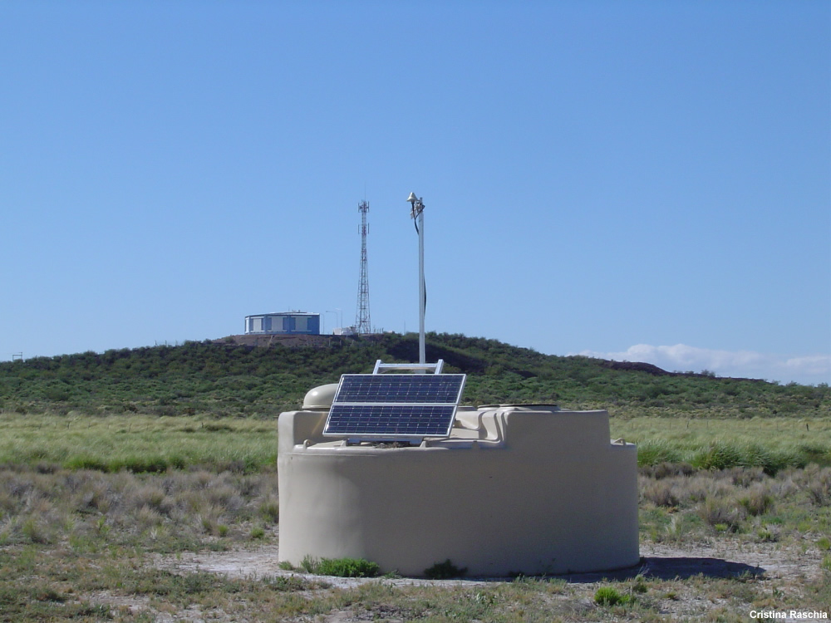
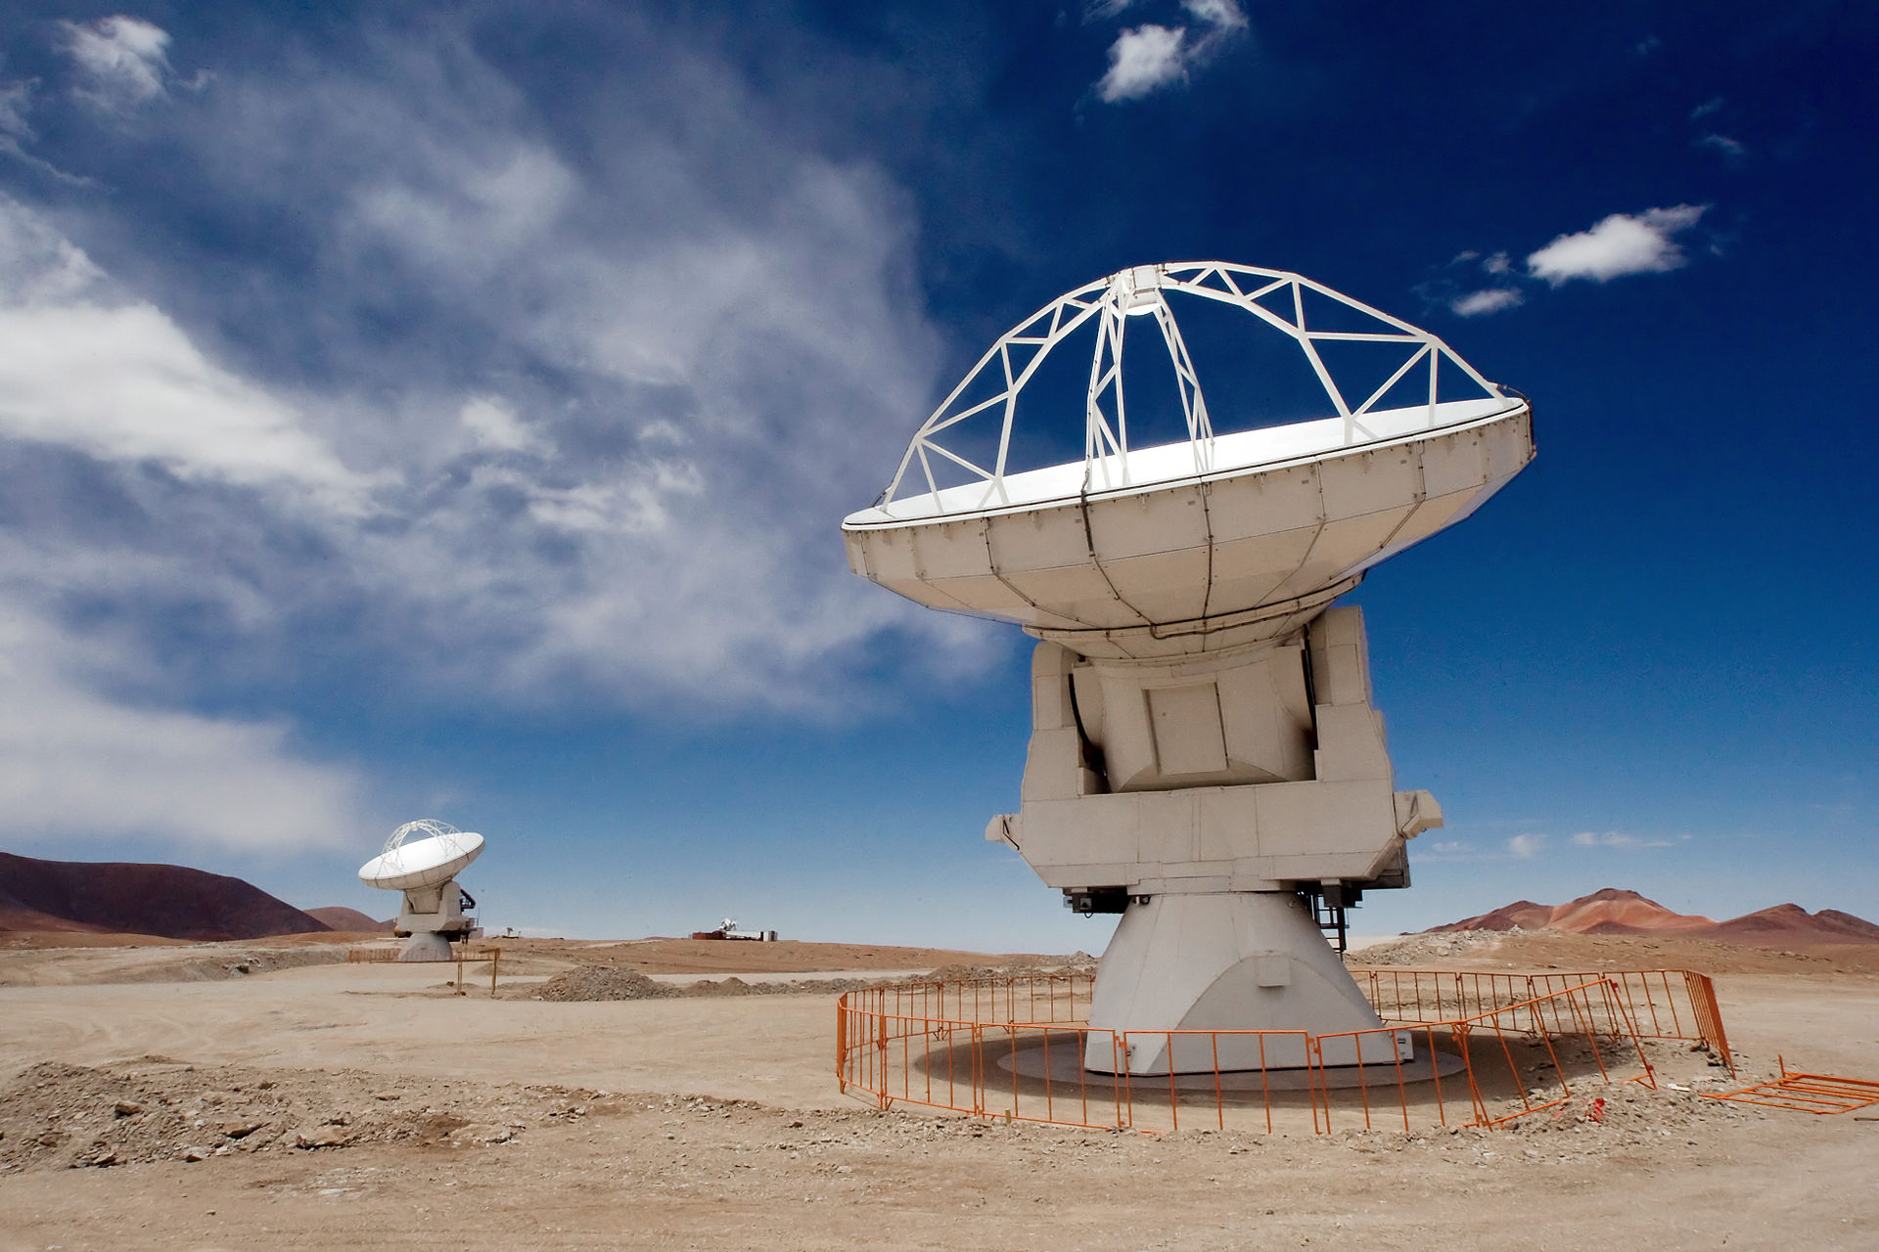
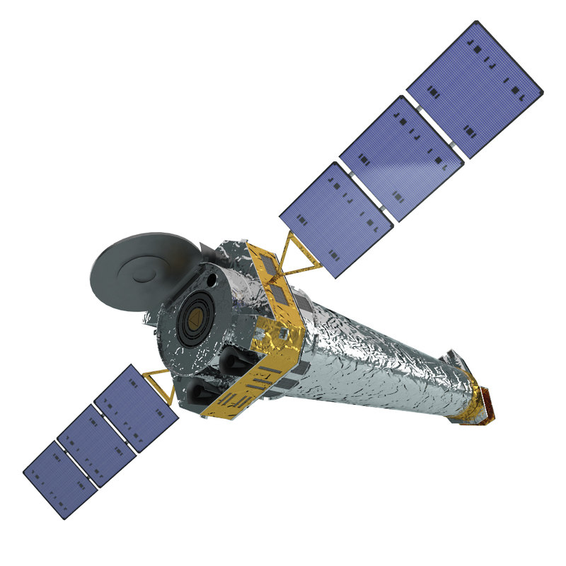
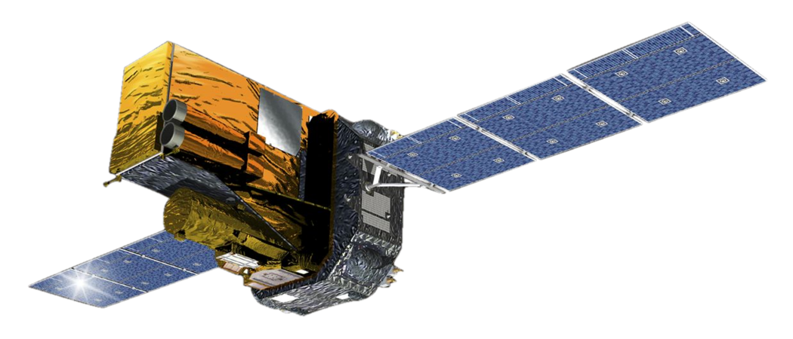
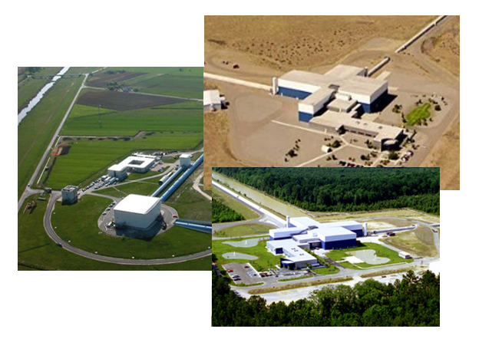
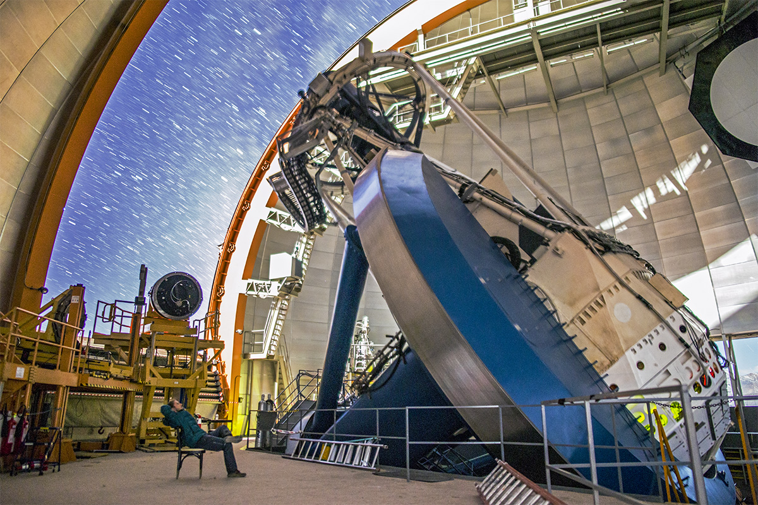
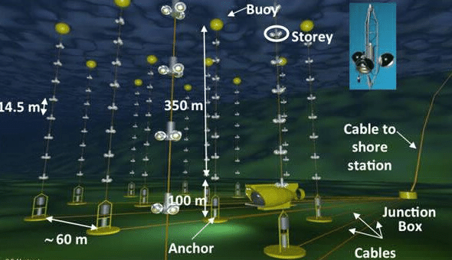
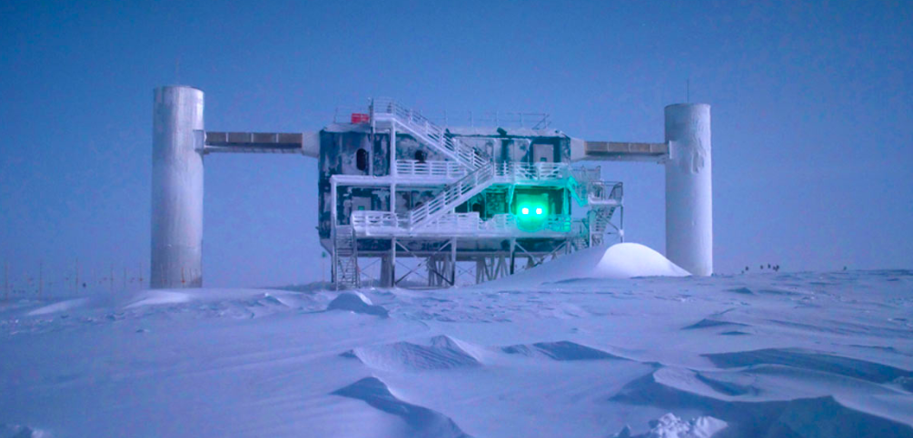
GW170817 Binary Neutron Stars Merger and Multi-Messenger Astronomy with GWs
Fermi
ALMA
Chandra
Pierre Auger
Integral
LIGO/VIRGO
DES
ANTARES
IceCube

Slide 20
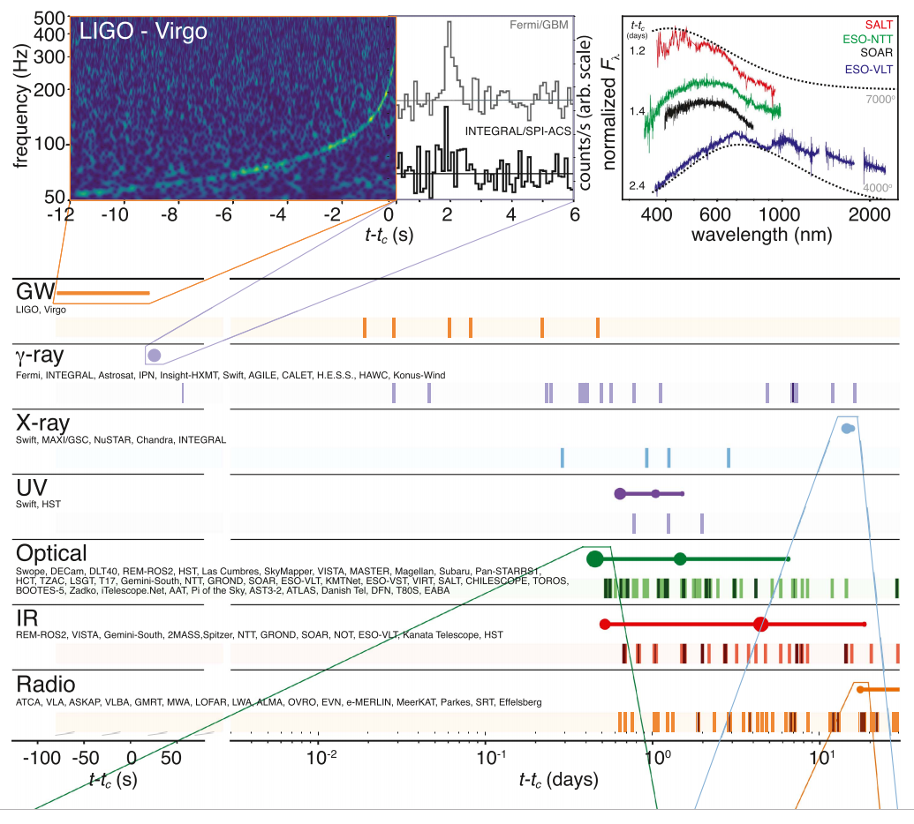
GW170817 Binary Neutron Stars Merger and Multi-Messenger Astronomy with GWs
First joint detection of gravitational and electromagnetic radiation from a single source
∼ 100 s long gravitational-wave signal (GW170817)
followed by a short Gamma Ray Burst (sGRB, GRB 170817A)
and an optical transient (SSS17a/AT 2017gfo) found in the host galaxy NGC 4993
Data compatible with Binary Neutron Stars merger (BNSs), followed by sGRB and a kilonova
Astroparticle Physics - Part 3 Gravitational Waves
<number>
Notes:
<number>
<number>

Slide 21
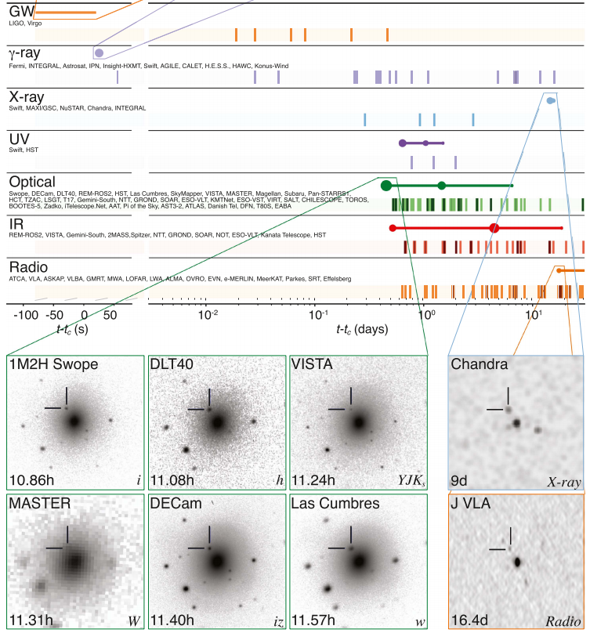
GW170817 Binary Neutron Stars Merger and Multi-Messenger Astronomy with GWs
First joint detection of gravitational and electromagnetic radiation from a single source
∼ 100 s long gravitational-wave signal (GW170817)
followed by a short Gamma Ray Burst (sGRB, GRB 170817A)
and an optical transient (SSS17a/AT 2017gfo) found in the host galaxy NGC 4993
Data compatible with Binary Neutron Stars merger (BNSs), followed by sGRB and a kilonova
Astroparticle Physics - Part 3 Gravitational Waves
<number>
Notes:
<number>
<number>

Slide 22


GW170817 Binary Neutron Stars and Multi-Messenger Astronomy with GWs
Chronology
On 2017 August 17 12:41:06 UTC the Fermi GBM onboard flight software triggered on, classified, and localized a GRB. A Gamma-ray Coordinates Network Notice (Fermi-GBM 2017) was issued at 12:41:20 UTC announcing the detection of the GRB 170817A
~ 6 minutes later, a GW candidate (GW170817) was registered based on a single-detector analysis of the LIGO Hanford data, consistent with a BNS coalescence, with merger time, tc, 12:41:04 UTC, less than 2 s before GRB 170817A.
A GCN Notice was issued at 13:08:16 UTC. Single-detector gravitational-wave triggers had never been disseminated before in low latency. Given the temporal coincidence with the Fermi-GBM GRB, however, a GCN Circular was issued at 13:21:42 UTC (LIGO Scientific Collaboration & Virgo Collaboration et al. 2017a) reporting that a highly significant candidate event consistent with a BNS coalescence was associated with the time of the GRB959.
An extensive observing campaign was launched across the electromagnetic spectrum in response to the Fermi-GBM and LIGO–Virgo detections, and especially the subsequent well-constrained, three-dimensional LIGO–Virgo localization
A bright optical transient (SSS17a, now with the IAU identification of AT 2017gfo) was discovered in NGC 4993 (at ~40 Mpc) by the 1M2H team SWOPE (August 18 01:05 UTC; Coulter et al. 2017a) less than 11 hr after the merger
Astroparticle Physics - Part 3 Gravitational Waves
<number>
Notes:
<number>

Slide 23
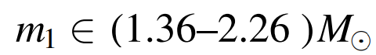
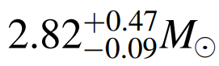
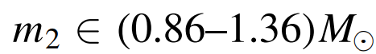
GW170817 Binary Neutron Stars and Multi-Messenger Astronomy with GWs
Gravitational-wave Observation
single-detector trigger, GCN Notice at 13:08:16 UTC
Three detectors reanalyses (LIGO Hanford, Livingstone, Virgo) confirmed high significance
GW lasted for ~100 s
Model: binary neutron stars coalescence
Virgo -> Livingstone (+22 ms) -> Hanford(+3 ms)
M_{BH}=
“However, for this event gravitational-wave data alone cannot rule out objects more compact than neutron stars such as quark stars or black hole”
Prompt Gamma Ray Burst
GRB detected at T0 = 12:41:06 UTC, Fermi-GBM at 12:41:20 UTC nitce (14s after detection) classified as a short GRB
Main pulse encompassing the GRB trigger time from T0 - 0.320 s to
T0 + 0.256 s, followed by a weak tail starting at T0 + 0.832 s and extending to T0 1.984 s
Astroparticle Physics - Part 3 Gravitational Waves
<number>
Notes:
<number>

Slide 24
GW170817 Binary Neutron Stars and Multi-Messenger Astronomy with GWs
Discovery of the Optical Counterpart
Broadband observing campaign in search of electromagnetic counterparts after the announcements of Fermi and Virgo-Ligo, using using ground- and space-based telescopes
1M2H team was the first to discover a bright optical transient on August 17 at 23:33 UTC (tc + 10.87 hr) with the 1 m Swope telescope at Las Campanas Observatory in Chile
https://arxiv.org/pdf/1710.05833.pdf
Broadband Follow Up
Plethora of observations performed by many experiments covering all the EM spectrum (infrared, radio, X-Rays, late Gammas…)
Neutrinos
Neutrinos: no highly energetic neutrinos found by the IceCube, ANTARES or Pierre Auger observatories
“[…] For the first time, gravitational and electromagnetic waves from a single source have been observed. The gravitationa lwave observation of a binary neutron star merger is the first of its kind. The electromagnetic observations further support the interpretation of the nature of the binary, and comprise three components at different wavelengths: (i) a prompt sGRB that demonstrates that BNS mergers are the progenitor of at least a fraction of such bursts; (ii) an ultraviolet, optical, and infrared transient (kilonova), which allows for the identification of the host galaxy and is associated with the aftermath of the BNS merger; and (iii) delayed X-ray and radio counterparts that provide information on the environment of the binary”
Astroparticle Physics - Part 3 Gravitational Waves
<number>
Notes:
<number>

Slide 25
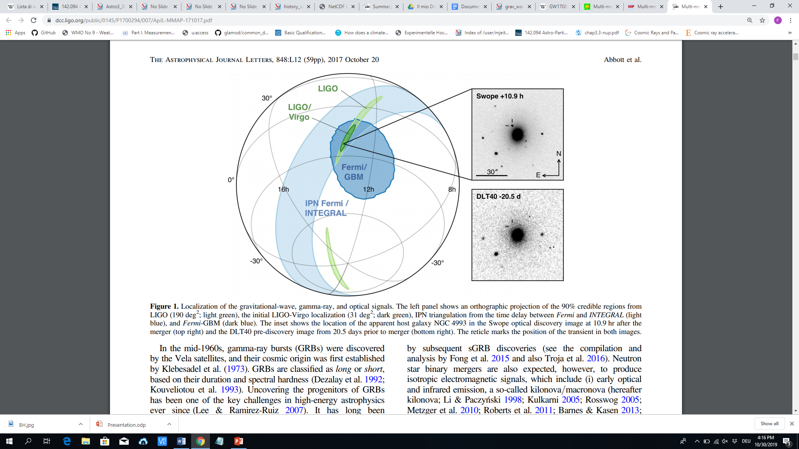
GW170817 Binary Neutron Stars and Multi-Messenger Astronomy with GWs
Fermi
Host Galaxy NGC 4993
INTEGRAL
(INTErnational Gamma-Ray Astrophysics)
Besides carrying diverse information, multiple detectors/exp improve the localization of the position of the possible source
Astroparticle Physics - Part 3 Gravitational Waves
<number>
Notes:
<number>

Slide 26
GW170817 Binary Neutron Stars and Multi-Messenger Astronomy with GWs
Fermi
Host Galaxy NGC 4993
! 10.9 h after the GW detection
INTEGRAL
~20 days before the GW detection
Besides carrying diverse information, multiple detectors/exp improve the localization of the position of the possible source
Astroparticle Physics - Part 3 Gravitational Waves
<number>
Notes:
<number>

Slide 27
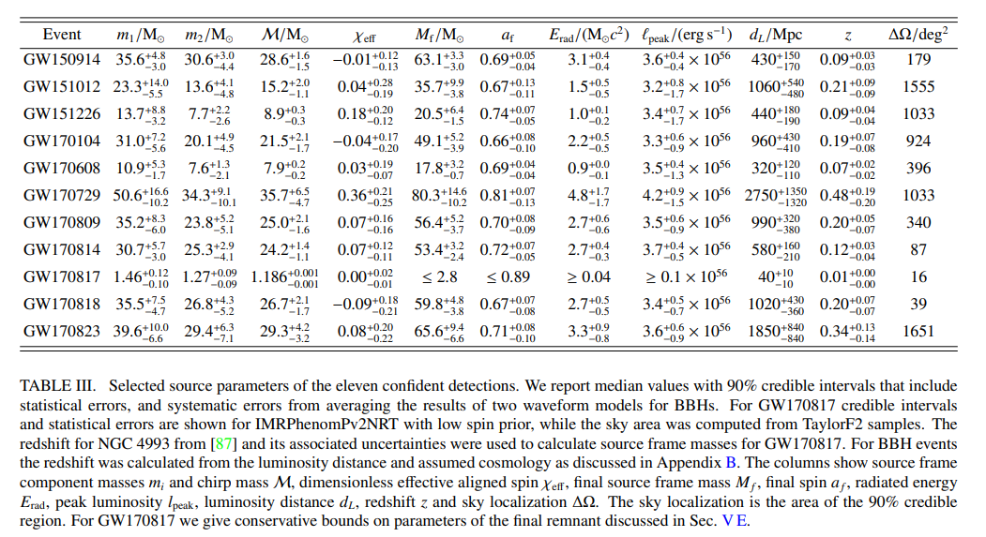
The O1/O2 2018 Events Catalog
On December 1, 2018 the LIGO/Virgo Collaboration published a catalog of their searches for gravitational-waves from stellar-mass coalescing compact binaries:
10 BHBH events
1 NSNS event
https://www.ligo.org/science/Publication-O2BBHPop/flyer.pdf
Astroparticle Physics - Part 3 Gravitational Waves
<number>
Notes:
<number>
<number>

Slide 28
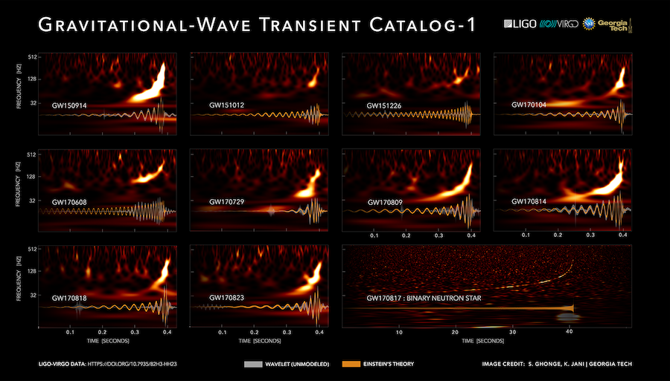
The O1/O2 2018 Events Catalog
Spectrograms and waveforms for the gravitational-wave transient catalog
The spectrogram color indicates a measure of signal strength; the increase of signal frequency with time clearly shows the characteristic "chirp" signature of a binary inspiral.
The waveforms shown at the bottom of each panel are produced from either a range of models based on Einstein's theory (orange) or a wavelet decomposition of the observed signal (gray).
Astroparticle Physics - Part 3 Gravitational Waves
<number>
Notes:
<number>
<number>

Slide 29
The O1/O2 2018 Events Catalog
https://www.youtube.com/watch?v=9xY53UyQjQs
Astroparticle Physics - Part 3 Gravitational Waves
<number>
Notes:
<number>
<number>

Slide 30
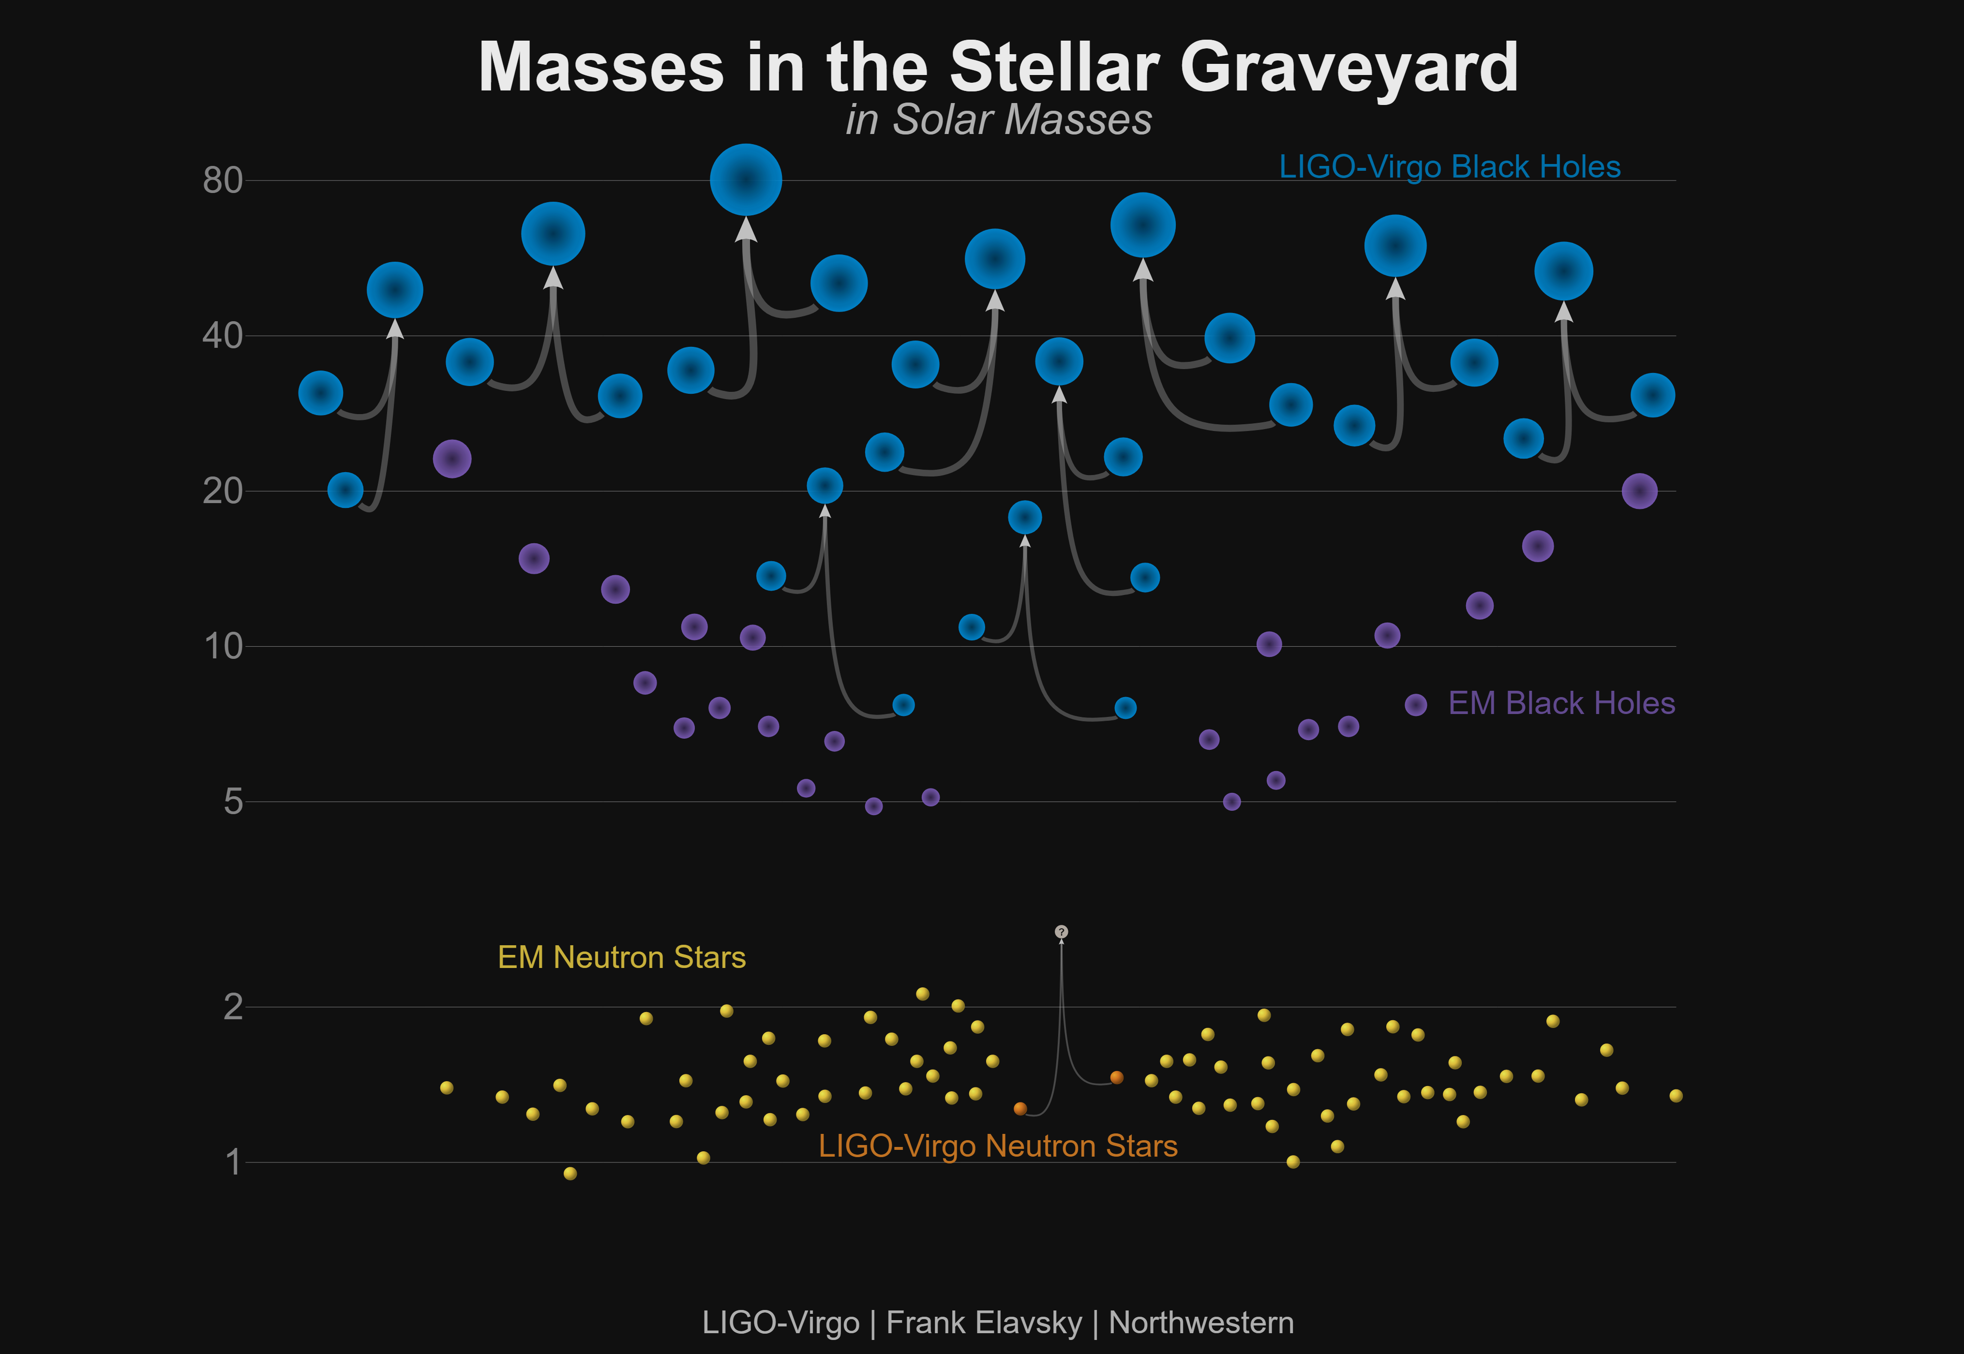
The O1/O2 2018 Events Catalog
Astroparticle Physics - Part 3 Gravitational Waves
<number>
Notes:
<number>
<number>

Slide 31
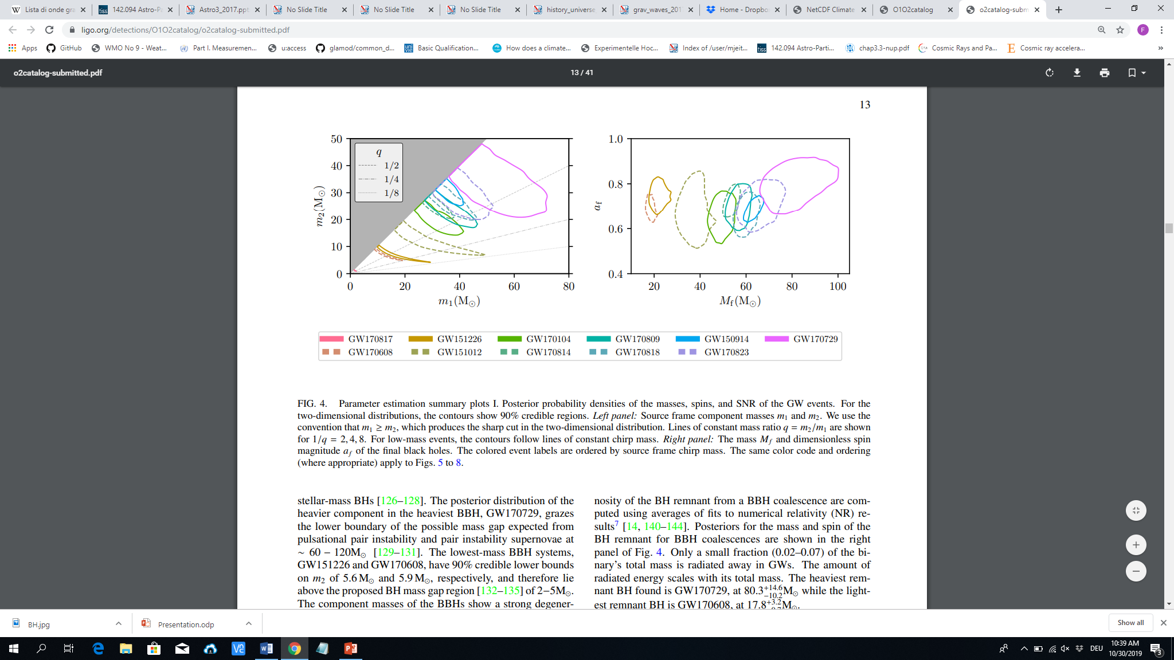

BHBH Merging Parameters
Projections in the Sky
Distributions of Masses
Astroparticle Physics - Part 3 Gravitational Waves
<number>
Notes:
<number>
<number>

Slide 32


GWs as a test for Cosmology and the Evolution of the Universe
It is possible to use the use the properties of the sources of the GWs observed to constrain Cosmology and evolution models
Neutron Star – Black Hole merger (NSBH) not seen yet
It is possible to set upper limits, with a certain confidence level (here 90%) on the number of events per volume of universe per unit of time
GW170817 used as a Standard Sirene (see next)
“GW measurements of black holes have already had profound implications for stellar astrophysics. Most black holes are heavier than the previously known population of stellar-mass black holes from EM obs. of X-ray binary systems; this told us something about how and where heavy BBHs might have formed. “
https://www.ligo.org/science/Publication-O2BBHPop/index.php
Astroparticle Physics - Part 3 Gravitational Waves
<number>
Notes:
<number>
<number>

Slide 33




The Future: Space Interferometers
Laser Interferometer Space Antenna (LISA) mission of the European Space Agency
http://www.esa.int/Science_Exploration/Space_Science/A_unique_experiment_to_explore_black_holes
https://www.elisascience.org/files/publications/LISA_L3_20170120.pdf
Astroparticle Physics - Part 3 Gravitational Waves
<number>
Notes:
<number>

Slide 34

The Future: Space Interferometers
Laser Interferometer Space Antenna (LISA) mission of the European Space Agency
http://www.esa.int/Science_Exploration/Space_Science/A_unique_experiment_to_explore_black_holes
https://www.elisascience.org/files/publications/LISA_L3_20170120.pdf
First dedicated space-based gravitational wave detector
Three spacecraft arranged in an equilateral triangle with sides 2.5 million km long, flying along an Earth-like heliocentric orbit
Each of the spacecraft contains two telescopes, two lasers and two test masses (each a 46 mm, 2 kg, gold-coated cube of gold/platinum)
2.5 million km corresponds to 8.3 seconds or 0.12 Hz
Astroparticle Physics - Part 3 Gravitational Waves
<number>
Notes:
<number>

Slide 35

The Future: Space Interferometers
Laser Interferometer Space Antenna (LISA) mission of the European Space Agency
http://www.esa.int/Science_Exploration/Space_Science/A_unique_experiment_to_explore_black_holes
“[…] But there is one extremely exciting experiment that we could only perform if both missions are operational at the same time for at least a few years: bringing sound to the ‘cosmic movies’ by observing the merger of supermassive black holes both in X-rays and gravitational waves”
Astroparticle Physics - Part 3 Gravitational Waves
<number>
Notes:
<number>

Slide 36

The Future: Space Interferometers
Astroparticle Physics - Part 3 Gravitational Waves
<number>

Slide 37

The Future: Space Interferometers
https://arxiv.org/pdf/1806.06979.pdf
With LISA it will be possible to observe e.g. BBHs months to week before the actual merger with great accuracy in determining the position in the sky
The actual merger could be then detected by aLIGO
This makes it possible to follow the merging events in time
EMRI (extreme mass ratio inspirals): e.g. BH of ~50 M⊙ inspiraling around a massive BH (~10⁶ M⊙) that should be common in the galactic centres
Stochastic gravitational waves background (e.g. from Inflation, phase transitions, spontaneous symmetry breaking)
[…]
Astroparticle Physics - Part 3 Gravitational Waves
<number>

Slide 38


GW170817 Measurement of H₀ – GWs as Standard Sirene
A GRAVITATIONAL-WAVE STANDARD SIREN MEASUREMENT OF THE HUBBLE CONSTANT
https://arxiv.org/pdf/1710.05835.pdf
SHoES: https://arxiv.org/pdf/1903.07603.pdf
Astroparticle Physics - Part 3 Gravitational Waves
<number>
Notes:
<number>
<number>

Slide 39


GW170817 Measurement of H₀ – GWs as Standard Sirene
A GRAVITATIONAL-WAVE STANDARD SIREN MEASUREMENT OF THE HUBBLE CONSTANT
https://arxiv.org/pdf/1710.05835.pdf
SHoES: https://arxiv.org/pdf/1903.07603.pdf
https://www.theguardian.com/science/2019/nov/02/hubble-constant-mystery-that-keeps-getting-bigger-estimate-rate-expansion-universe-cosmology-cepheid
??? Maybe New Physics needed in the ΛCDM ???
[Next Lecture]
“With two years of observation LISA can measure the Hubble constant more accurately than any present method, and with a comparable accuracy to that expected from other future space missions.”
[Hubble's constant in SI units is 1.62x10⁻¹⁸ / s]
1 Pc = 3.26 light years
https://sci.esa.int/web/planck/-/60504-measurements-of-the-hubble-constant
Astroparticle Physics - Part 3 Gravitational Waves
<number>
Notes:
<number>
<number>

Slide 40
Some Extras

Slide 41

Stellar Evolution (i.e. Where BHs and NSs come from)
Take home
Star evolution mostly depends on the mass of the original gas cloud
Metallicity i.e. chemical composition impacts fusion processes
For initial mass Mi > 0.08 M○ -> white dwarfs
For Mi > 8 M○ -> Supernova (SN) explosion and NS remnant
For Mi > 8 M○ -> SN explosion and formation of BHs (fallback or direct)
Stellar evolution end with the creation of White Dwarfs, SNe, Neutron Satrs, Black Holes which are sources of gravitationl waves!
[ Typical numbers of neutron star:
Mass ~ 1.4 M○
radius ~ 10 Km
magnetic field 10¹² Gauss (LHC: 4 T = 40k Gauss, average in Milky way ~ microGauss, Earth surface~0.2 Gauss) ]
Astroparticle Physics - Part 3 Gravitational Waves
<number>
Notes:
<number>
<number>

Slide 42



Stellar Evolution (i.e. Where BHs and NSs come from)
Isochrone: curve on the HR diagram representing a population of stars of ~ same age (like e.g. globular clusters)
By fitting the stellar population with a model isochrone, it is possible to estimate the population age
Each feature (e.g. turning points, branches,…) of the isochrone can be explained by models of stellar evolution (type/size/region of nuclear fusion processes)
hotter
colder
Astroparticle Physics - Part 3 Gravitational Waves
<number>
Notes:
<number>
<number>

Slide 43



Pulsars
http://www.jb.man.ac.uk/distance/frontiers/pulsars/section1.html
Pulsars (Pulsating Radio Source) are rapidly spinning neutron stars
Their rotation period span from the order of milliseconds to the order of ~8 seconds
Pulse: collection of radio waves of different frequencies
Rotation period extremely stable, although the rotation speed slows down with time
„Lighthouse“ effect
Composite optical/X-ray image of the Crab Nebula, showing synchrotron emission in the surrounding pulsar wind nebula, powered by injection of magnetic fields and particles from the central pulsar.
Optical image of the Crab nebula (NOAO).
The arrow marks the position of the pulsar.
Astroparticle Physics - Part 3 Gravitational Waves
<number>
Notes:
<number>
<number>

Slide 44


Standard Candle and Standard Sirens
Determining accurate astrophsical object distances is extremely important and typically challenging
Standard candles (def. By Henrietta Leavitt) are astronomical objects used as physical distance indicators
SNe Ia are also standard candles since the total luminosity is known from models
They are caused by the mass accretion of a Carbon-Oxygen white dwarf from a stellar companion, eventually exceeding the Chandrasekhar limit for degenerate electron (1.44 M ⊙ )
(they were crucial for the discovery of the accelerated expansion of the universe due to Dark Energy )
Atrophysical objects / events with known properties and defined, calculable brightness
From observed luminosity one can extract the distance
Cepheides stars
Supernovae Ia
Astroparticle Physics - Part 3 Gravitational Waves
<number>
Notes:
<number>
<number>

Slide 45

Standard Candle and Standard Sirens
Parameters
Observed Data
Astroparticle Physics - Part 3 Gravitational Waves
<number>

Slide 46

Discrepancies in the measurements of the Hubble Parameter
“ Large Magellanic Cloud Cepheid Standards Provide a 1% Foundation for the Determination of the Hubble Constant and Stronger Evidence for Physics Beyond ΛCDM”
https://arxiv.org/abs/1903.07603
Astroparticle Physics - Part 3 Gravitational Waves
<number>

Slide 47
http://users.math.cas.cz/~krizek/cosmol/pdf/E21.pdf
-> critic on the estimation of the Masses of the BHs due to simplification in the treatment of GW (neglect total redshift !)
Astroparticle Physics - Part 3 Gravitational Waves
<number>

